Slide 1
Introduction to IT Infrastructure Technology

Slide 2
What Is IT Infrastructure Technology-Definitions
Information technology infrastructure is defined broadly as a set of information technology (IT) components that are the foundation of an IT service; typically physical components (computer and networking hardware and facilities), but also various software and network components.
According to the itil foundation course glossary, it infrastructure can also be termed as “all of the hardware, software, networks, facilities, etc., That are required to develop, test, deliver, monitor, control or support IT services.
The term IT infrastructure includes all of the information technology but not the associated people, processes and documentation.

Slide 3
With an IT infrastructure, a company can:
Provide a positive customer experience by providing uninterrupted access to its website and online store.
Develop and launch solutions to market with speed.
Collect data in real time to make quick decisions.
Improve employee productivity

Slide 4
How do the components of IT infrastructure work?
The components of IT infrastructure are made up of interdependent elements, and the two core groups of components are
hardware and software.
Hardware uses software—like an operating system—to work.
And likewise, an operating system manages system resources and hardware.
Operating systems also make connections between software applications and physical resources using networking components

Slide 5
Types of IT Infrastructure
The two primary types of IT infrastructure are traditional and cloud infrastructure

Slide 6
Traditional infrastructure
A traditional IT infrastructure is made up of the usual hardware and software components: facilities, data centers, servers, networking hardware desktop computers and enterprise application software solutions.
Typically, this infrastructure setup requires more power, physical space and money than other infrastructure types.
A traditional infrastructure is typically installed on-premises for company-only, or private, use.

Slide 7
Cloud infrastructure
A cloud computing IT infrastructure is similar to traditional infrastructure.
However, end users can access the infrastructure via the internet, with the ability to use computing resources without installing on-premises through virtualization.
Virtualization connects physical servers maintained by a service provider at any or many geographical locations.
Then, it divides and abstracts resources, like storage, to make them accessible to users almost anywhere an internet connection can be made. Because cloud infrastructure is often public, it’s usually referred to as a public cloud.

Slide 8
EVOLUTION OF SYSTEMS
From 1960—when the revolution started in the IT field—till today, the computer system with its memory and processing capability has seen numerous changes.
Starting from large ENIAC to mainframe to midrange to personal computers to client server to new age systems, the system has undergone revolutionary changes in terms of the services that they are providing. And still, the evolution continues.

Slide 9
Starting with 1960
1964, IBM launched s-360, which revolutionized the IT scenario.
The s-360 was the first system that was a general purpose machine which was able to handle large quantity of data transaction and processing speed.
The s-360 was a powerful and consistent machine, which could support COBOL and FORTAN language.

Slide 10
In the early 1970s, the cost and power of integrated circuits (IC) started to fall which laid the path to the development of the new age system.
In 1971, IBM launched s-370, a developed version of s-360.
The s-370 utilized a new operating system, having large memory and numerous processes existing in the main memory at the same time.
The system was competent of managing a large database and its speed was much faster than that of its predecessor

Slide 11
Reinvent the Mainframe
The 1990s saw the world of mainframes in complete swing.
During the 1970s, many organizations started centralizing their databases and large processors which required faster system
The encouraging economic growth in the 1980s allowed numerous organizations to expand both locally as well as globally

Slide 12
A totally new architecture that was being developed over a decade was launched as System/390 (S/390), having the operating system OS/390.
The system was proposed with a 48-bit memory addressing field that was more advanced than any other system of that period.

Slide 13
Changing of Midrange and Client–Server Platforms
The word ‘server’ was itself going through a transformation phase about this time.
As midrange computers developed into further networks-oriented, and as the traditional application and database servers grown to become more powerful, the dissimilarity in terms of controlling the two categories began to fade.
This was particularly correct in the case of storage management.
By now, midrange and client–server platforms were both running various applications.

Slide 14
Growing Use of PCs and Networks
By the end of the twentieth century, PCs and the network equipments that interconnected them became part and parcel of everyday life.
The processing power of desktop computers has also changed considerably.
Desktop models were not the only kind of PCs that were available in the market in the 2000s.
Manufacturers presented more and more small versions commonly known as laptops, palmtops and personal digital assistants

Slide 15
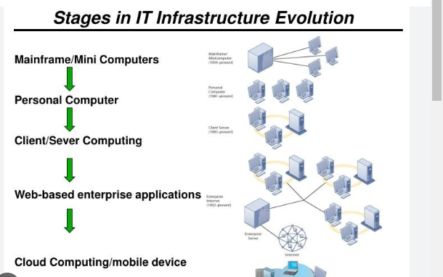
History of IT Infrastructure Technology,

Slide 16
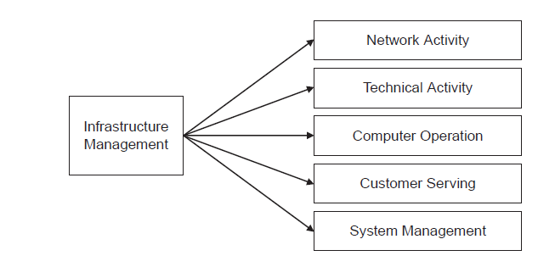
INFRASTRUCTURE MANAGEMENT ACTIVITIES

Slide 17
Network Activity
Network services are implemented on one or more servers to offer shared resources to the client’s machines.
These services are configured on computer LAN to make sure that security is available while the client is trying to access different shared resources and the operations are user friendly.
These services assist the network to run smoothly and efficiently. The common services included in the network activity are as follows:
􀂄 Authentication services
􀂄 Directory services
􀂄 DNS (domain name server)
􀂄 E-mail
􀂄 Dynamic host configuration protocol
􀂄 Printing
􀂄 Network file system

Slide 18
Technical Activity
The technical activities can be categorized into two different categories:
System Administration
These services include timely update, backup and recovery of the system. This activity includes the following services:
􀂄 Taking regular backup
􀂄 Applying operating system update
􀂄 Responsibility of security
􀂄 Installing, configuring and maintaining the new hardware or software of the system
􀂄 System performance tuning
Trouble-shooting
􀂄 Adding, deleting or updating any user account

Slide 19
Database Administration
These services take care of database and make sure that the properties of database (ACID property) are preserved all the time. This activity includes the following services:
􀂄 Creating and testing backups
􀂄 Confirming database reliability
􀂄 Making sure that the database is accessible to the authorized user for maximum time
􀂄 Assisting the database administrators, programmers and engineers to efficiently use database

Slide 20
Computer Operation
The computer operation consists of all the operations that are executed on the computer system which comprise of the services which become active once the network is created.
The computer operation group and network service communicate with each other for enhanced functionality.

Slide 21
Customer Services
These services comprises of the services that an organization offers to its customer or end user or even to its internal employees through help desk or customer care or desktop support.
The customer services can be categorized into the following

Slide 22
Help Desk
Help desk is an information providing and assistance resource that troubleshoot problems of the organization products or services.
The helpdesk is important for an organization because:
􀂄 It is the initial encounter of the customer with that of the organization.
􀂄 The help desk permits multiple desks to integrate into one single desk and then transfer problems to respective desks.

Slide 23
Desktop Support
Desktop support is responsible to provide services to different desktops, laptops and other PDA’s of the organization.
The helpdesk team assigns the desktop support team with the second level side problems that the first level side was not able to resolve

Slide 24
System Management
This group is a distinct department that is exclusively responsible for determining those infrastructure processes which are most critical to a particular IT environment of an organization.
This department generally reports to any one of the infrastructure groups depending upon its process.
In an organization, the infrastructure and all key processes are controlled by a system management group that directly reports to the leader.

Slide 25
Growth of Internet
Internet is continuously spreading day and night all over the world.
The internet community is making the world community literate all over the world, or a common person, who is related to interconnecting information technology or working with technology.
At present, more internet resources are being used on desktops, laptops, and cell phones.
Where multiple internet users are managing global information through local and global network technology connections. Where the internet has become more popular among professionals, engineers, laymen, individuals, students, even all global communities, etc.

Slide 26
Nowadays most of the work is done with the help of computer technology, artificial intelligence, or a machine.
As such, after the use of the internet in computer technology, it becomes more popular with information easily accessible.
Where as of june 2012 internet users were 2336 million 33.3 percent of the world’s population. And it is now increasing in great size every day now. Which is being used by anyone for their commercial and non-commercial purpose.

Slide 27
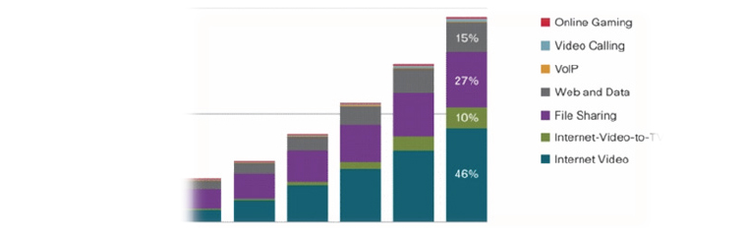
Anatomy of the internet.

Slide 28
The term internet anatomy refers to physical body structures or internet worldwide connectivity.
Where all elements work with networking terms. We already know that the internet is a globally spread network.
Therefore, any legal internet user uses many of the services from connected network services in the context of the internet’s applications, utilities, or web-enabled features.

Slide 29
Application of the internet.
Surfing
Downloading
Upload
E-mail
Web hosting
Video conference
Social connectivity

Slide 30
IT systems issues/Challenges in IT Infrastructure Management
Lack of Employee (Internal) Security Measures
Outdated Equipment and Software
New Technology Integration
Data Loss and Recovery
A Lack of Comprehensive Solutions

Slide 31
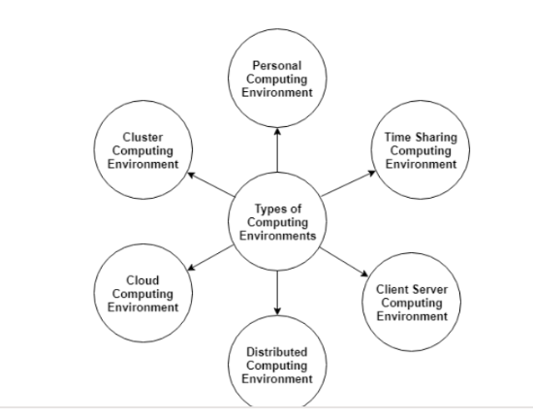
complexity of today's computing environment

Slide 32
Total Cost of Complexity Issues

Slide 33
Solving the Paradox of Storage Choice
Faced with a diverse storage ecosystem, IT often finds themselves making a choice between purchasing all storage from a single vendor, or shopping between different vendors, even building their own with customizable software on commodity servers.
IT must carefully weigh these options to ensure they make the best choice for both the top and bottom line

Slide 34
The Cost of Avoiding Data Migrations and Upgrades
Many vendors upsell new storage devices to customers every few years. These upgrades usually deliver new features, but few IT teams look forward to a migration.
Typically, migrations take months of planning and consume a large portion of IT’s budget and resources.
Since it’s so hard to move data without disrupting applications, IT commonly overspends to purchase excess capacity well in excess of expected future demands.

Slide 35
The Cost of Downtime
While IT is always looking to reduce complexity and costs and make life easier, the cost that matters most when it comes to complexity is the increased risk of downtime.
The more systems IT is managing, the more human involvement is required. The more human involvement that exists, the greater the risk of unplanned downtime, and this downtime can be disastrous for business

Slide 36
Moore's Law
Moore's Law states that the number of transistors on a microchip doubles every two years.
The law claims that we can expect the speed and capability of our computers to increase every two years because of this, yet we will pay less for them.
Another tenet of Moore's Law asserts that this growth is exponential. The law is attributed to Gordon Moore, the co-founder and former CEO of Intel.

Slide 37
In 1965, Gordon E. Moore, the co-founder of Intel, made this observation that became known as Moore's Law.
Moore's Law has been a driving force of technological and social change, productivity, and economic growth that are hallmarks of the late 20th and early 21st centuries.

Slide 38
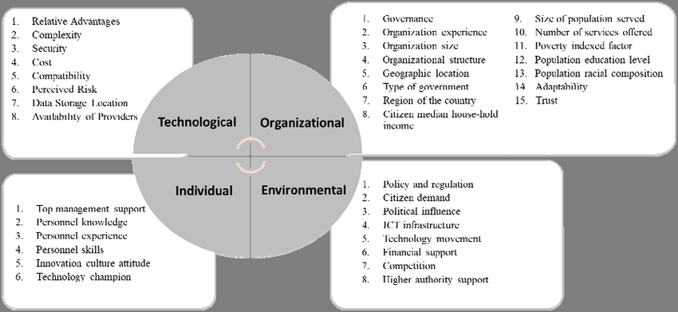
Factors to consider in designing IT Organizations

Slide 39
Understand Your IT network goals
Every company has different goals and objectives. Thus, their IT network will also be designed according to these goals. First, you must understand the goal of your IT network. This will help you in picking the right resources and components

Slide 40
Security and Connectivity
Network connectivity is expanding with time. Now, you can even use your mobile phones for connecting to business networks.
Employees can use their mobile devices for accessing their company mail. This will ensure that they can work from any remote location in the world.
It is important to balance these needs while designing your network. But, you have to also consider the security challenges while designing your network. You have to figure out where you are storing your data.
Some companies are using cloud-based solutions for storing your data.

Slide 41
It is also important to implement access control in your IT network.
This will help you in reducing the insider threats.
Also, you have to set up a firewall for protecting your network.
You can also use access servers for protecting your network from attackers.
But, these solutions can slow down your operations. Thus, you must implement all these solutions during the design phase.

Slide 42
Disaster Recovery Plan
Every business must have a DR plan. This will ensure that your company can recover from any disaster.
Also, you should design this plan with your IT network. Make sure to backup your data in remote locations.
Thus, you can access your data from anywhere in the world.
Also, you must have backup power for dealing with natural disasters. This will ensure that your services won’t go down due to power outage.
Your recovery plan must include all the building disasters, man-made disasters, and office disasters.

Slide 43
Training and scalability
It is important to train your employees about the new policies. This will ensure that your employees know about your new network policies. Also, you must conduct a cybersecurity seminar for your employees. Most of the network breaches due to human error. Thus, it is important to train your employees about basic security terms.

Slide 44
Scalability is another important element for any IT network. You should need to upgrade and update your IT resources. Thus, you must understand your network growth. This will help you in avoiding surprise costs. It will also ensure that your organization is ready for expansion.

Slide 45
Redundancy
You must have backup devices for storing your sensitive data. If you have a small organization, then you can use two separate networks. This will allow you to do development work on the mirror network. You can use your main network for running important applications. It is important to have redundant services and components in your network. This will help you in reducing the downtime of your network.

Slide 46
Identifying System Components to manage
An Information system is a combination of hardware and software and telecommunication networks that people build to collect, create and distribute useful data, typically in an organization. It defines the flow of information within the system. The objective of an information system is to provide appropriate information to the user, to gather the data, process the data and communicate information to the user of the system.

Slide 47
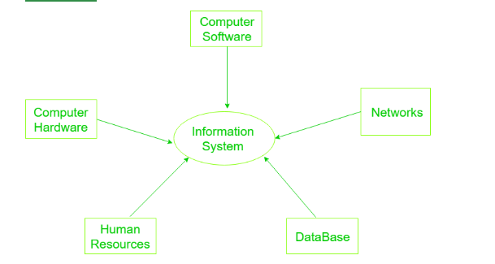

Slide 48
Computer Hardware: Physical equipment used for input, output and processing. The hardware structure depends upon the type and size of the organization. It consists of an input and an output device, operating system, processor, and media devices. This also includes computer peripheral devices.

Slide 49
Computer Software: The programs/ application program used to control and coordinate the hardware components. It is used for analysing and processing of the data. These programs include a set of instruction used for processing information.
Software is further classified into 3 types:
System Software
Application Software
Procedures

Slide 50
Databases: Data are the raw facts and figures that are unorganized that are later processed to generate information. Softwares are used for organizing and serving data to the user, managing physical storage of media and virtual resources. As the hardware can’t work without software the same as software needs data for processing. Data are managed using Database management system.

Slide 51
Network:
Networks resources refer to the telecommunication networks like the intranet, extranet and the internet.
These resources facilitate the flow of information in the organization.
Networks consists of both the physical devices such as networks cards, routers, hubs and cables and software such as operating systems, web servers, data servers and application servers.

Slide 52
Human Resources: It is associated with the manpower required to run and manage the system. People are the end user of the information system, end-user use information produced for their own purpose, the main purpose of the information system is to benefit the end user. The end user can be accountants, engineers, salespersons, customers, clerks, or managers etc

Slide 53
In software engineering, a design pattern is a general solution to a common problem: A design pattern isn’t a finished design that can be transformed directly into code; it is a description or template for how to solve a problem that can be used in many different situations.

Slide 55
Patterns for IT systems management
The patterns focus especially on breaking down the functional boundaries between IT planning, solution development, and service management, and enabling the accuracy of the core information store at the heart of well-managed IT. The concepts of Demand and Portfolio Management cross these boundaries and are advisable places to start. The concept of the Configuration Management System (aka CMDB) also is a tricky area, and it’s hoped the patterns described here will assist the many organizations pondering how to keep such a comprehensive data store current.

